Slide 1


Eternal Works
Social Media Plan

Slide 2

Agenda
Executive Summary
Positioning Statement
Brand Work
Process and Findings
Sample Content
Content Calendar & Budget
Recommendations

Slide 3
Executive Summary
Notes:
This semester we developed a social media plan for Eternal Works. You reached out to us for help because you are a client-focused business and do not have your own social media specialist running your accounts. You need a social media recommendation on what the best method is to market to your target audience, the IT and Software industry, to gain more business.
In the last 4 months, we have focused on creating a content and marketing recommendation, written as a social media plan, for Eternal Works. This presentation outlines the recommendation and contains the process we went through to come to our conclusions.

Slide 4
Positioning Statement
Eternal Works is a Virginia Beach-based growth agency that provides user-centric, data-driven solutions. This company serves small and medium-sized businesses that are driven by growth and supporting their marketing, sales, and services teams. They are a HubSpot Gold Certified Solutions Partner. Eternal Works' primary focus is to design sites that attract more visitors, generate more leads, and helps to close sales faster.

Slide 5
Brand Work

Slide 6
Brand Statement
EW provides graphic design, branding and online marketing to successful customers in a fun environment with a genuine voice helping them feel confident and have increased business!

Slide 7
Process

Slide 8
Process- Findings
Look over E-W’s website and social media platforms
Look into E-W’s current clients
Look into the competition
To take an inventory of the main keywords and phrases E-W uses throughout their site and current content.
We took to Instagram and Facebook to figure out the best hashtags to use.
Notes:
To gain an understanding
To gain an understanding
To get an understanding of what they are doing in order to increase business.
Used Wordstream to search the popularity of those terms, as well as additional terms, to see which would be the best to use in future content.
The next slide includes the most useful terms and hashtags we found during this step in the process.

Slide 9
Keywords and Hashtags
Keywords | Popularity/month | Hashtags | Total Popularity
SEO Marketing | 757,936 | #design | 267,264,879
connect | 550,000 | #smallbusiness | 53,911,280
SEO | 137,500 | #marketing | 51,098,847
solutions | 77,542 | #marketingdigital | 23,198,614
search optimization | 62,612 | #it | 23,133,038
roi | 61,625 | #technology | 17,786,795
generate sales | 60,858 | #digitalmarketing | 15,528,850
web design | 60,500 | #tech | 13,689,139
digital marketing | 60,500 | #brand | 33,118,788

Slide 10
Target Segment

Slide 11
Demographics
Gender: 70% men, 30% women
Education: Bachelor’s and beyond
Occupations: IT and Software industry professionals such as CEOs, VPs of marketing, VP of sales, sales, business owners, designers, and programmers, customer experience managers
Ages: 35-60
Location: United States
Psychographics
Personality & attitudes: goal oriented, light hearted, business focused, hard working, extroverted, introverted, friendly
Values: good work-life balance, building relationships, job security, expanding business, dependability, efficiency, passion, optimism, positivity, organization, problem-solving skills, creativity, communication
Lifestyles: busy, multitasker, balancing family with work, social life, live in own in apartments/houses, travel, workaholic
Interests: Technology, software, website design, increasing revenue, increasing traffic and leads, staying up-to-date on industry, user experience
The target audience consists of IT and Software professionals looking for help with inbound marketing, and/or website design. Businesses included are those who have been in business for 3+ years, are making more than $3 Mil/yr, but less than $100 mil, have 10+ employees, and aren’t making the amount of revenue they want/need so far.

Slide 12
User Personas
Notes:
We created 5 user personas, however we are showing 3 of our top personas that demonstrates your demographic clearly
I will start with a short summary, and go through their role, goals, and challenges

Slide 13

1
Terrell Yarbrough (45) - Looking for inbound marketing
Roles
  He is the CEO of an Education software company
Goals
  Gain leads and deals by utilizing inbound showcasing strategies, explicitly centered around online media promotions and publications.
Challenges
  The current representatives are graphic designers whose knowledge is best suited for developing websites, versatile applications, and business management software and they do not have an individual who is proficient in online marketing.
Notes:
Goals: Have sufficient business volume so they can extend their activity by welcoming more individuals to the team to configure, create, and maintain sites and applications made. In the long run they'd prefer to turn into a host site for websites.
Challenge: They do not need any assistance with their site, however, they do require help with developing an inbound marketing strategy

Slide 14
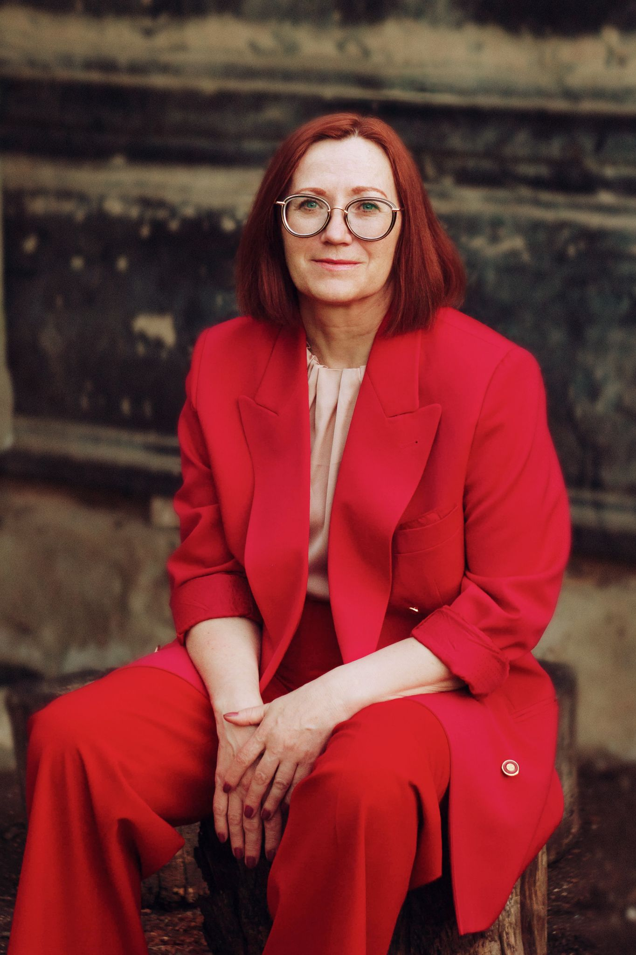
2
Anisa Mcdaniel (53) - Looking for inbound marketing
Roles
  Work in sales for a data analytics software company
Goals
  The company website could use an upgrade, but they are more focused on gaining leads, traffic, and sales.
Challenges
  The company does not have a social media presence and needs help in starting one. Company is upbeat and friendly, and needs help showing this to potential clients.
Notes:
Challenge: While looking over the business and doing some research into how they can increase sales more effectively, she realized the company has no social media presence. They do send out emails and do a lot of traditional marketing, but she concluded that if they were to also engage on social media, their number of qualified leads would increase, giving the sales team more prospects to communicate with and turn into paying clients. She and her team are currently looking for companies to collaborate with to help develop that online presence.

Slide 15

3
Jake Smith (55) - Looking for website design
Roles
  Owner of a software testing business.
Goals
  He has a goal of increasing the level of engagement his current and potential clients have with the company’s website.
Challenges
  No one in his team has a design background so the website is currently basic and doesn’t stand out from their competitors.
Notes:
Goals: Needs help with his website design as his team is more technology and software focused.
Challenges: He also needs help with inbound marketing, but currently they can’t afford it. So, he hopes that an update to the website will increase business to a level where they can afford to get help on their marketing efforts.
Thinks he can’t afford, but probably can.

Slide 16
Content Creation

Slide 17
Themes
The Team at Eternal Works
Inbound Marketing
Client Success
Tips and Tricks
Services Provided
Business Culture
Website SEO
Website Design
IT & Software Industry
Grow your Business

Slide 18
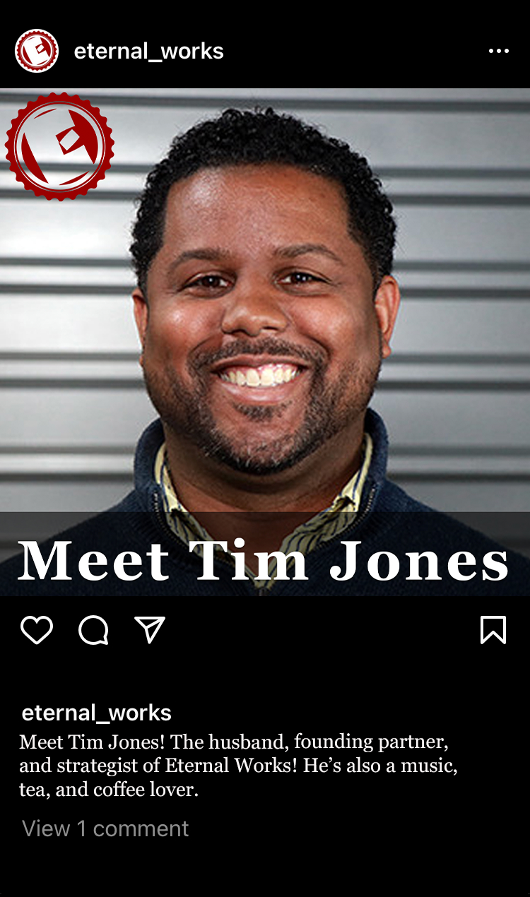
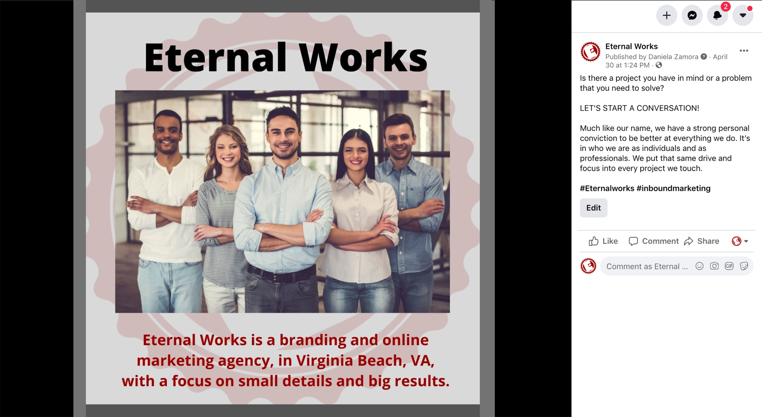
The Team at Eternal Works
Notes:
Left Pic
Platform: Facebook/LinkedIn
Caption: Is there a project you have in mind or a problem that you need to solve? LET'S START A CONVERSATION! Much like our name, we have a strong personal conviction to be better at everything we do. It’s in who we are as individuals and as professionals. We put that same drive and focus into every project we touch.
Hashtags: #Eternalworks #inboundmarketing
Why it works: This post would be the start of introducing who is E-W.
Right Pic
Platform: Instagram
Caption: Meet Tim Jones! The husband, founding partner, and strategist of Eternal Works! He’s also a music, tea, and coffee lover.
Hashtags: #Marketing #DigitalMarketing #Eternalworks #inboundmarketing #smallbusiness #technology #software #IT
Why it works: These posts would give people a more personalized and individualized look at who they would be, or are, working with if they decide to engage your help. It makes them relate to you and inevitably trusts you and your abilities more.
Notes: There would be a post for each person on your immediate team. Captions would give information on who the person is. The main photo could be followed up with more images of the person working in their environment. This is meant to be a way to let people know more about who you are and what you do for the company.

Slide 19
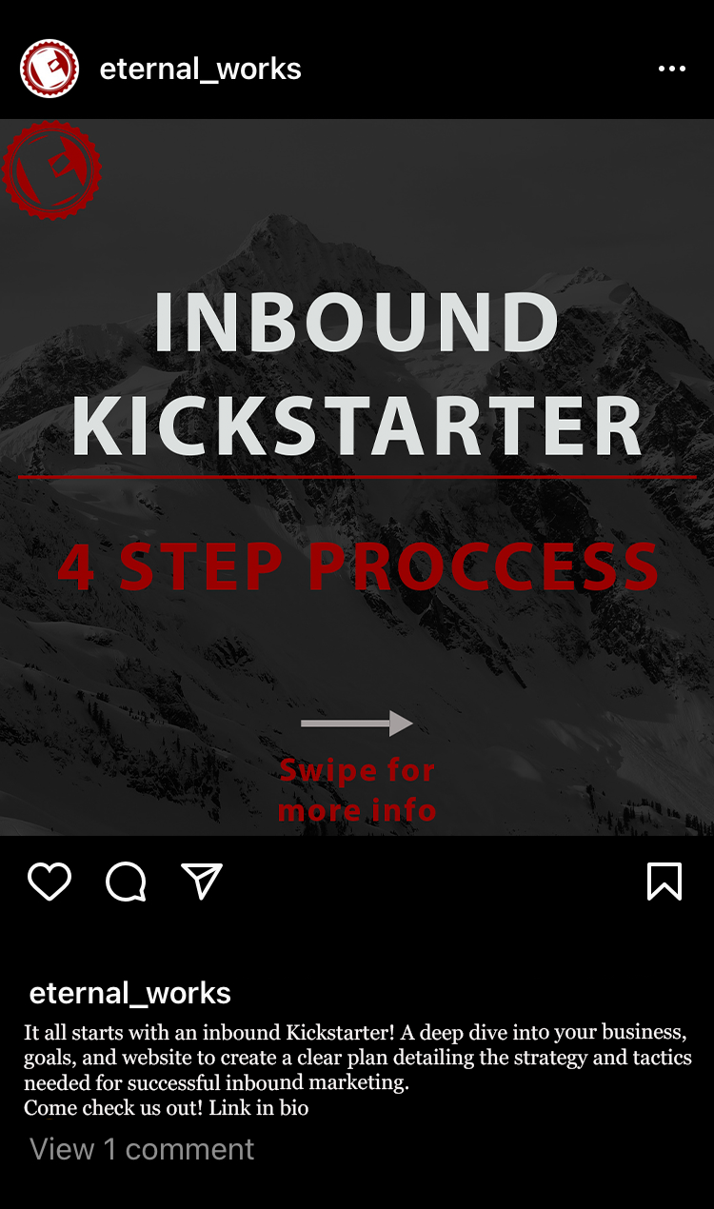
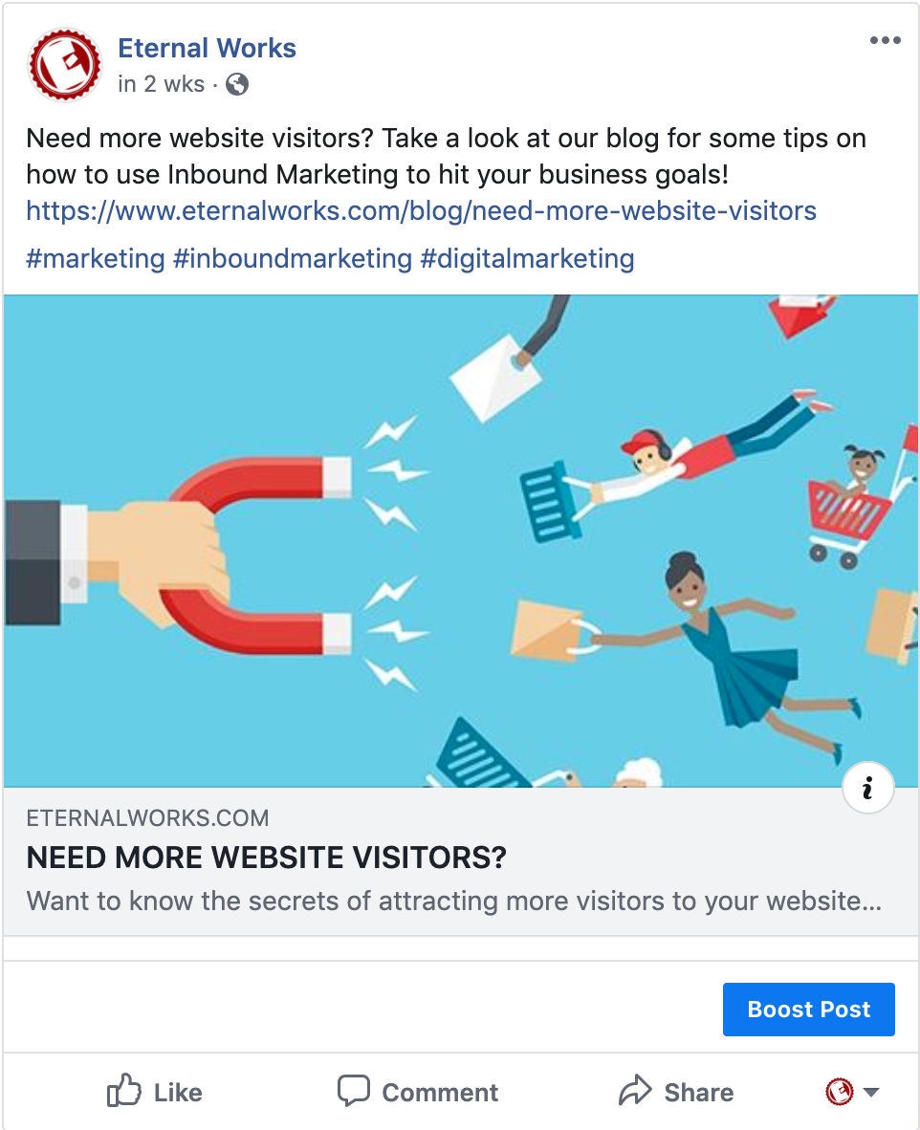
Inbound Marketing
Notes:
Left Pic
Platform: Instagram
Caption: It all starts with an inbound Kickstarter! A deep dive into your business, goals, and website to create a clear plan detailing the strategy and tactics needed for successful inbound marketing.
Come check us out! Link in bio
Hashtags: #inboundmarketing #EternalWorks #marketing #marketingdigital #smallbusiness #technology #software #IT
Why it works: This post series can be an ad run on Instagram to show potential leads a little snippet of what EW has to offer in their services. The contrasting colors grab the viewer's attention and the arrow makes them want to swipe to see more before getting them interested in learning more about EW and how your services can benefit their business.
Right Pic
Platform: Instagram/Facebook
Caption: Need more website visitors? Take a look at our blog for some tips on how to use Inbound Marketing to hit your business goals! https://www.eternalworks.com/blog/need-more-website-visitors
Hashtags: #marketing #inboundmarketing #digitalmarketing
Why it works: This would be an advertisement to the blog post for people to come upon and click to read more, taking them to the main website.
Notes: Post is a link to the blog post.

Slide 20
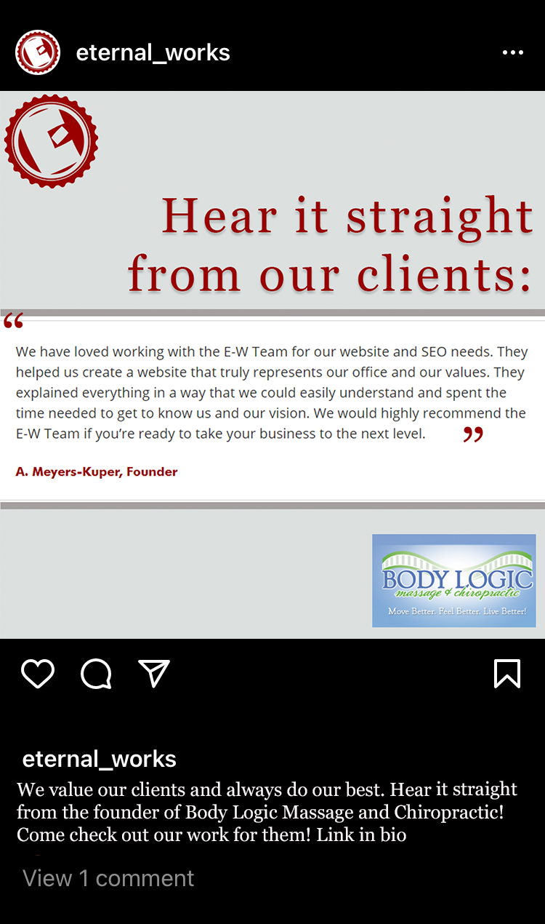
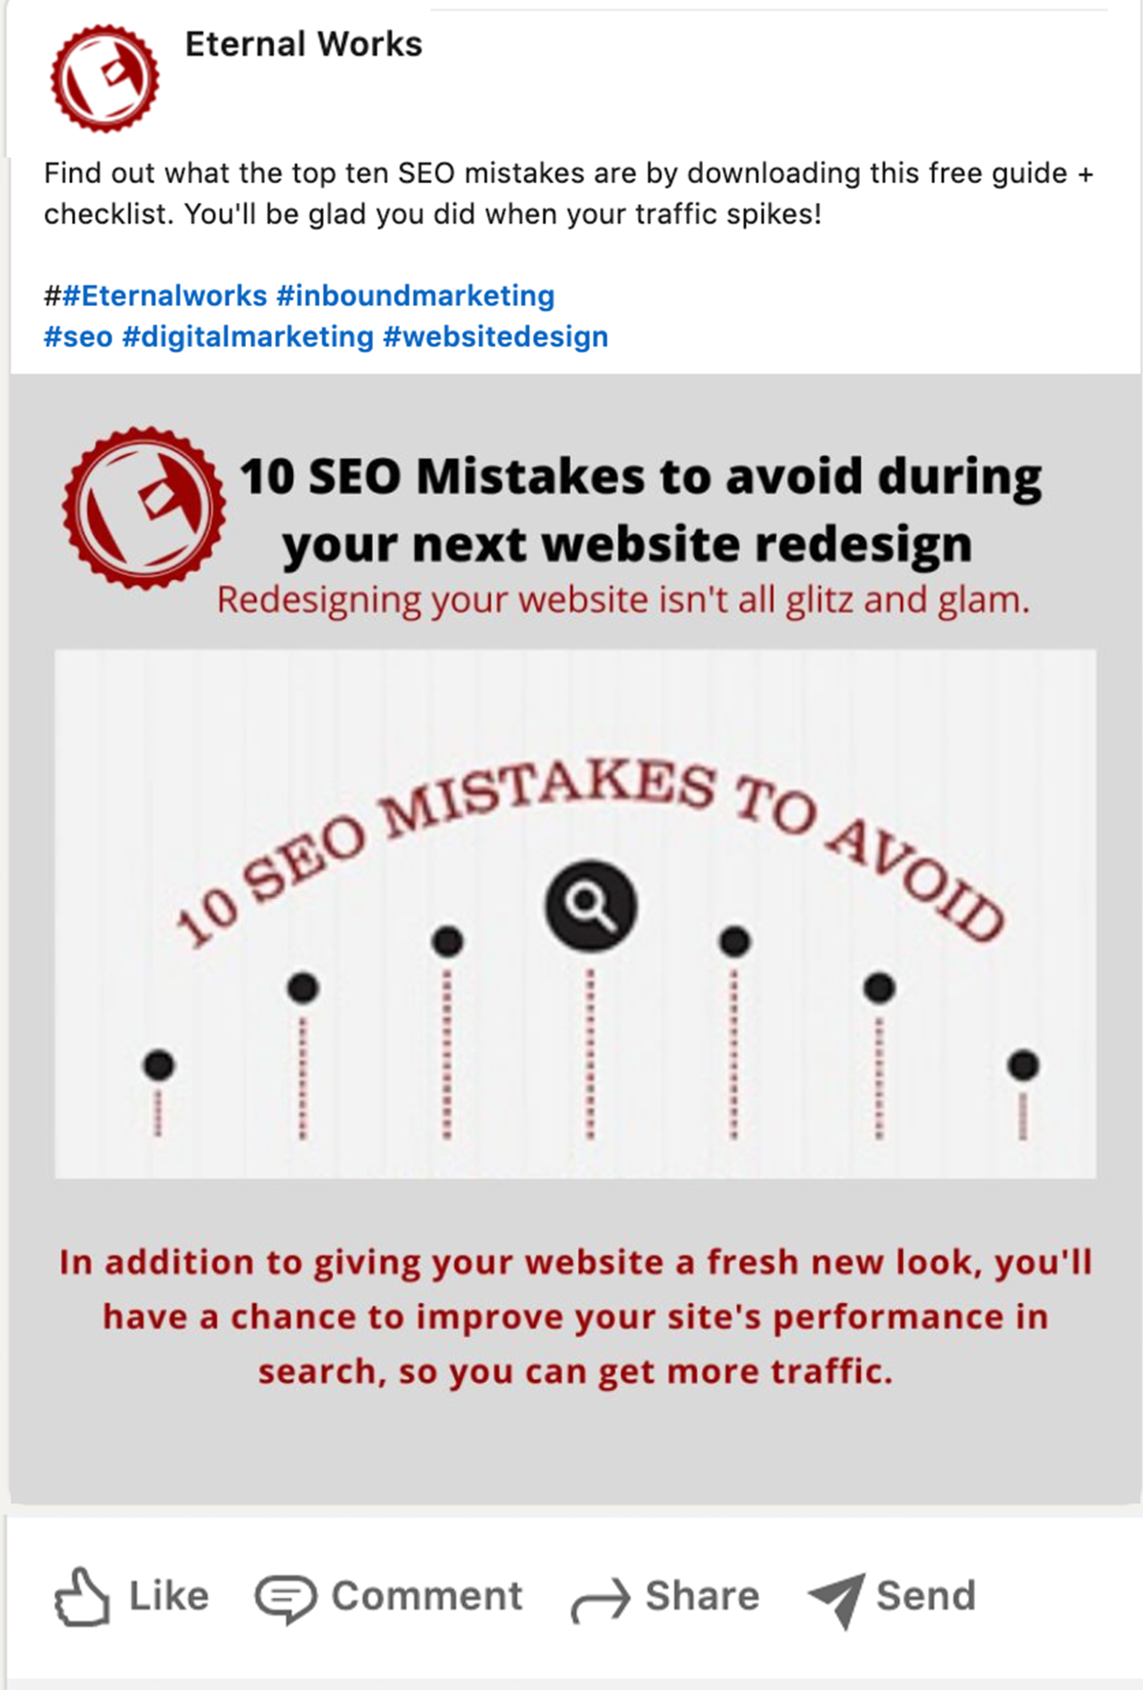
Client Success
Tips and Tricks
Notes:
Platform: Instagram
Caption: We value our clients and always do our best. Hear it straight from the founder of Body Logic Massage and Chiropractic! https://bodylogicvb.com/ Come check out our work for them! Link in bio
Hashtags: #inboundmarketing #digitalmarketing #eternalworks
Why it works: This post would be to help gain more credibility in the eyes of your viewers. They would see the great testimony and feel like your business is worth investing in.
Right Pic
Platform: LinkedIn
Caption: Find out what the top ten SEO mistakes are by downloading this free guide + checklist. You'll be glad you did when your traffic spikes!
Hashtags: #Eternalworks #inboundmarketing
Why it works: This post will have the link to the guide for people to click on. This would build the amount of traffic to the website and gain new leads.

Slide 21
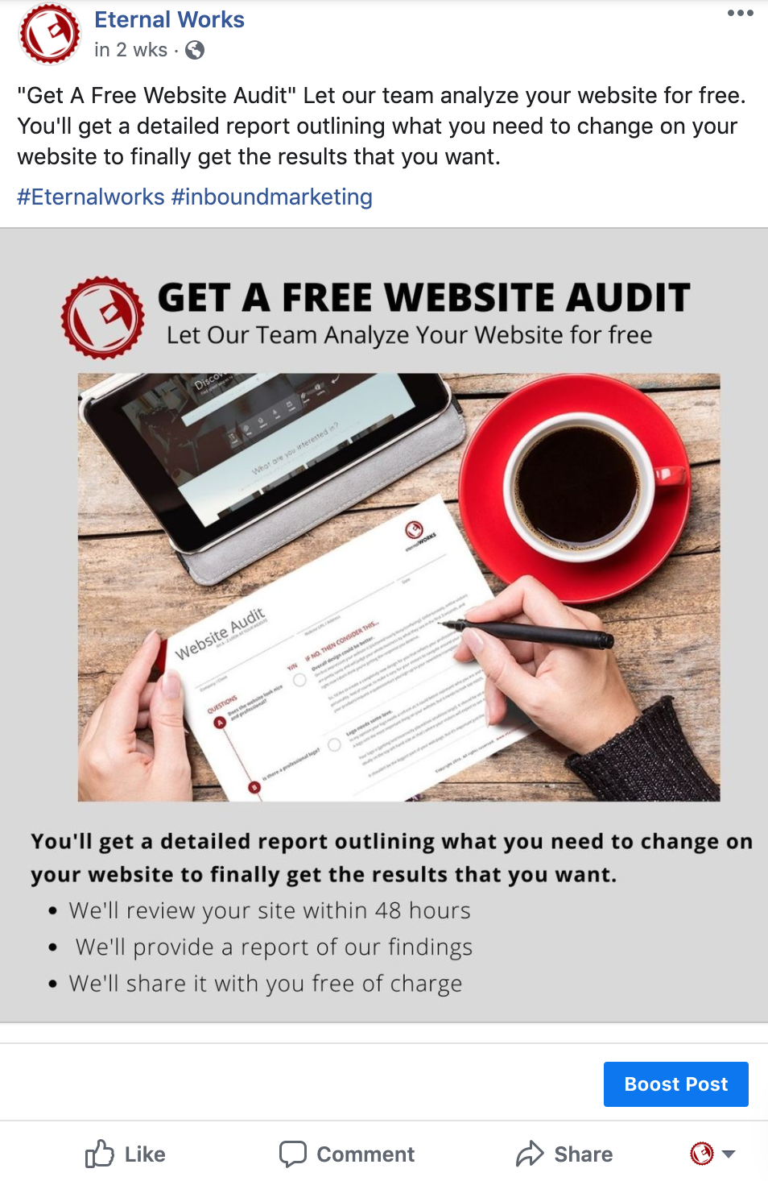
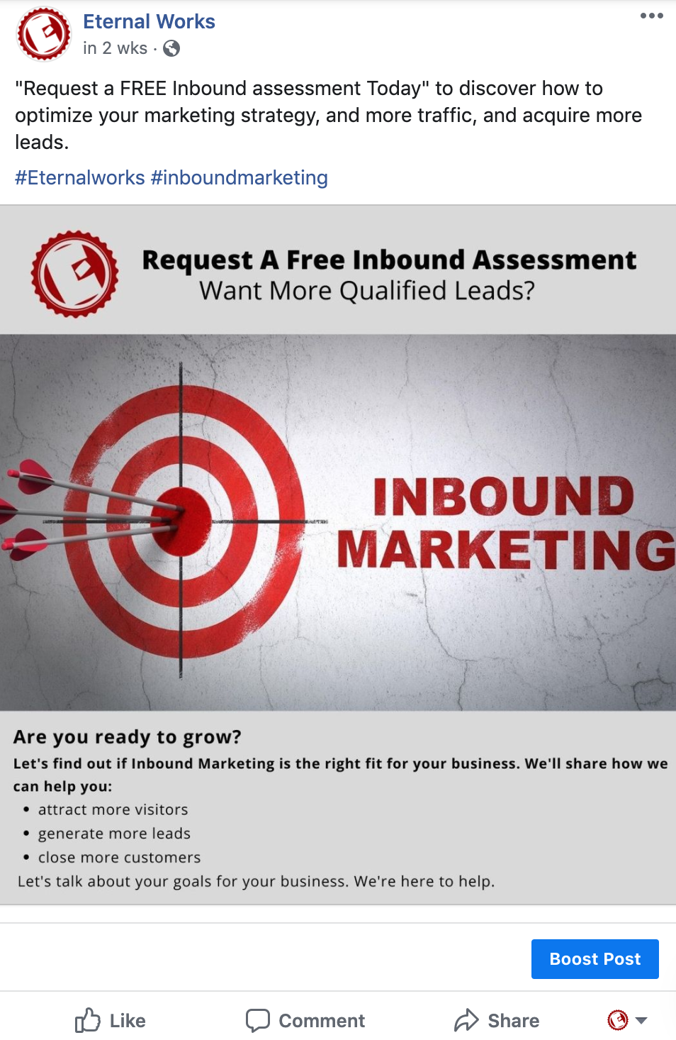
Services Provided
Notes:
Left Pic
Platform: LinkedIn/Facebook
Caption: "Get A Free Website Audit" Let our team analyze your website for free. You'll get a detailed report outlining what you need to change on your website to finally get the results that you want.
Hashtags: #Eternalworks #inboundmarketing
Why it works: This post will gain audience attention to click learn more about how to get one of your free website audits. This will lead to gaining more clients
Right Pic
Platform: Facebook/LinkedIn
Caption: "Request a FREE Inbound assessment Today" to discover how to optimize your marketing strategy, and more traffic, and acquire more leads.
Hashtags: #inboundmarketing #marketing #digitalmarketing #Eternalworks
Why it works: This post will catch the viewers attention with the question asked and the word “free” on there. It will end up driving more traffic and new leads to your website

Slide 22
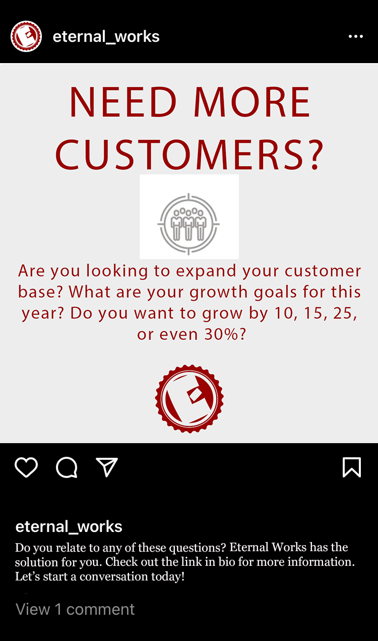
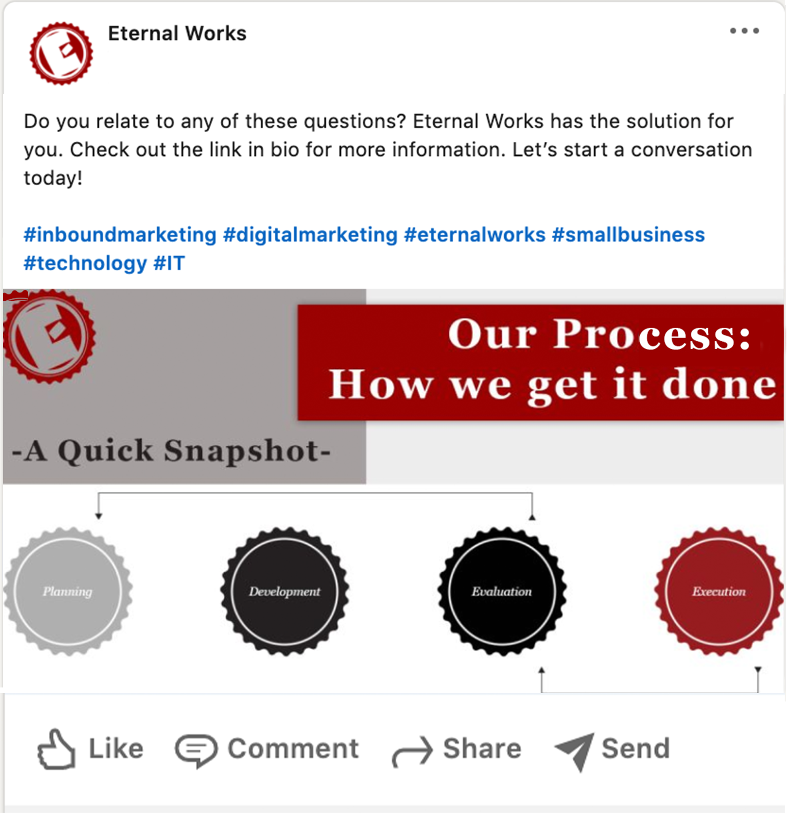
Services Provided
Notes:
Left Pic
Platform: Instagram
Caption: Do you relate to any of these questions? Eternal Works has the solution for you. Check out the link in bio for more information. Let’s start a conversation today!
Hashtags: #inboundmarketing #digitalmarketing #eternalworks #smallbusiness #technology #IT
Why it works: This post would catch the attention of viewers with its bolded font headline and short question for people to read. They would end up swiping to see what the other questions are and if they relate to them personally. If they do, it would entice them to go to the bio for the link to the homepage. Creating leads and prospects for business and increasing engagement levels with the posts.
Notes: I would use the actual vector images of the symbols and make the lines black or a color that stands out so that amount of grey is limited. Or even add more color and maybe some more imagery so that the posts aren’t so bland and will have an easier time catching the attention of the viewer’s eye. This is meant to be a post that has multiple images for people to scroll.
Right Pic
Platform: LinkedIn/Facebook
Caption: Take a look at how we get things done! https://www.eternalworks.com/about/process
Hashtags: #marketing #inboundmarketing
Why it works: This would give people a bit of information on how you conduct business and what steps are involved when partnering with you and your team. It helps give them a sense of comfort that they have a process they can expect will be followed. Eventually helping ease their minds and make them more receptive to your information when talking with them. It could also make them want to start that initial conversation with you.
Notes: Meant to be a post with a link so there will be a call to action to follow the process page on the website

Slide 23
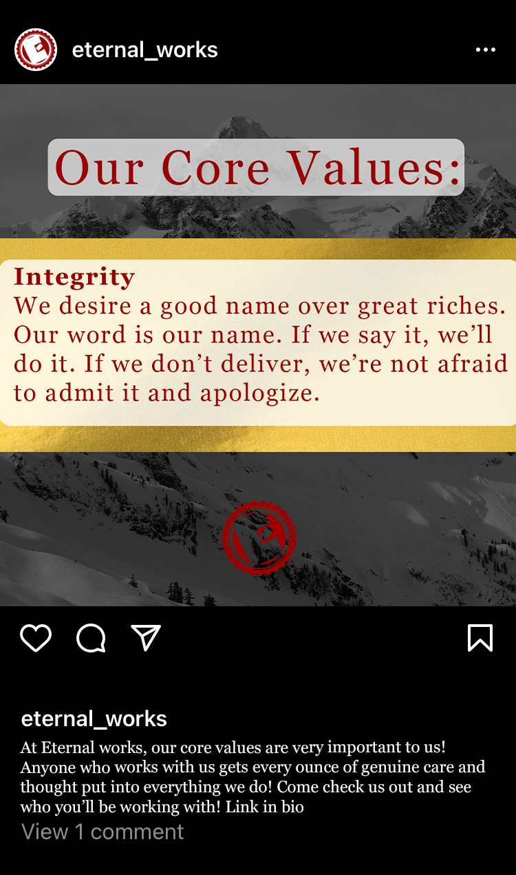
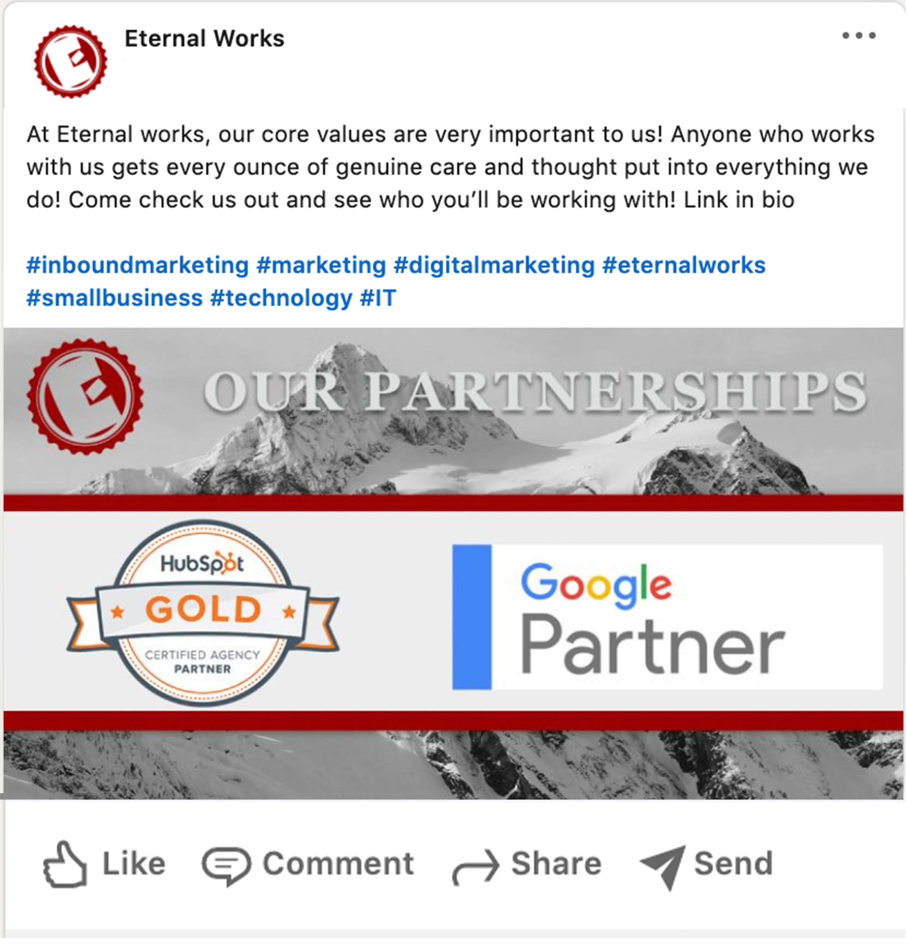
Business Culture
Notes:
Left Pic
Platform: Instagram
Caption: At Eternal works, our core values are very important to us! Anyone who works with us gets every ounce of genuine care and thought put into everything we do! Come check us out and see who you’ll be working with! Link in bio
Hashtags: #inboundmarketing #marketing #digitalmarketing #eternalworks #smallbusiness #technology #IT
Why it works: People like to see who a company is before and during the time they do business with them. They want to be sure the company they are buying from is a good, supportive company that cares about its customers.
Notes: I would use images of the team and reframe where the descriptions are to wrap around the people’s faces so that you are matching the core values with a real person in the business instead of a random person from the internet.
Right Pic
Platform: LinkedIn/Facebook
Caption: We are fortunate to be Hubspot Gold and Google partners as a growth agency. Come take a look at our process and what we do! https://www.eternalworks.com/
Hashtags: #marketing #inboundmarketing
Why it works: This post is to help show the credibility of your business to your viewers. They will see you are partnered with these well-known companies and build confidence in them in your abilities.
Notes: Use your image of the mountain that is on the homepage. Also, this format could be used for the awards you have been given to give people tangible evidence that your business works for your clients.

Slide 24
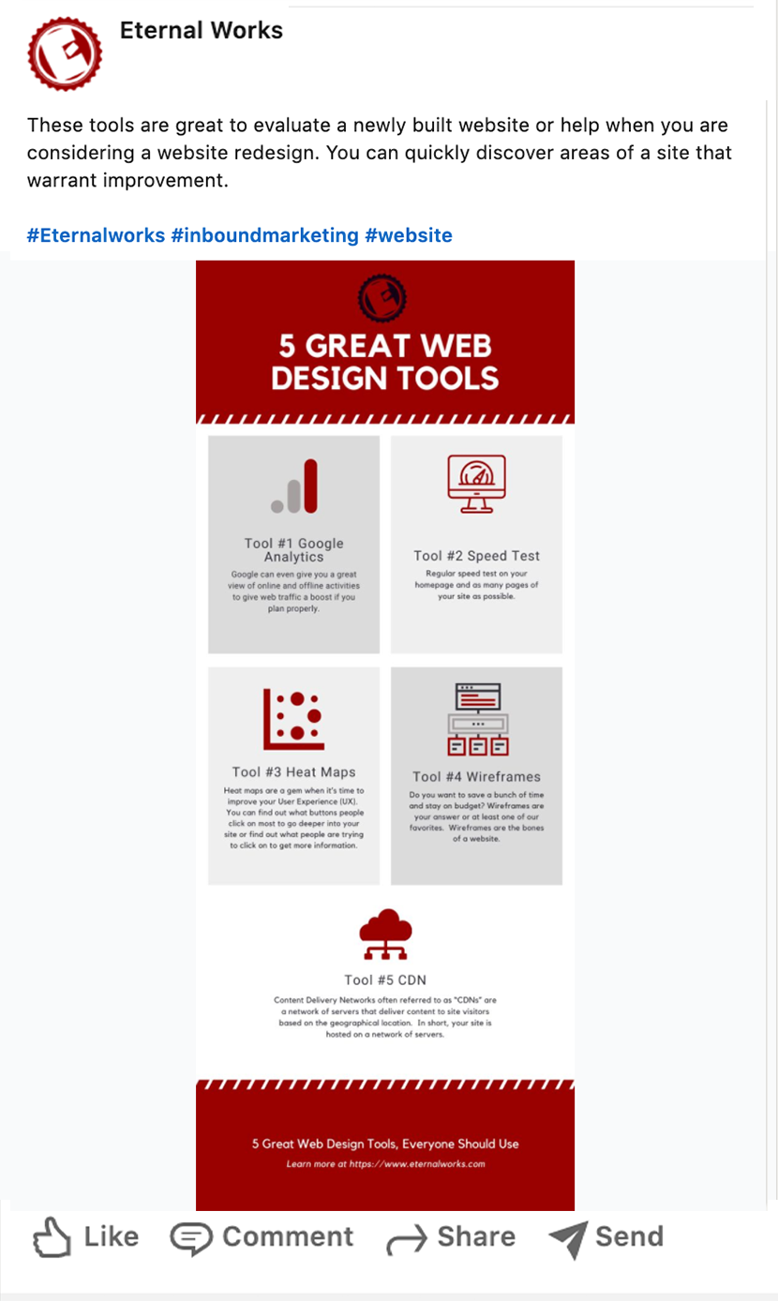
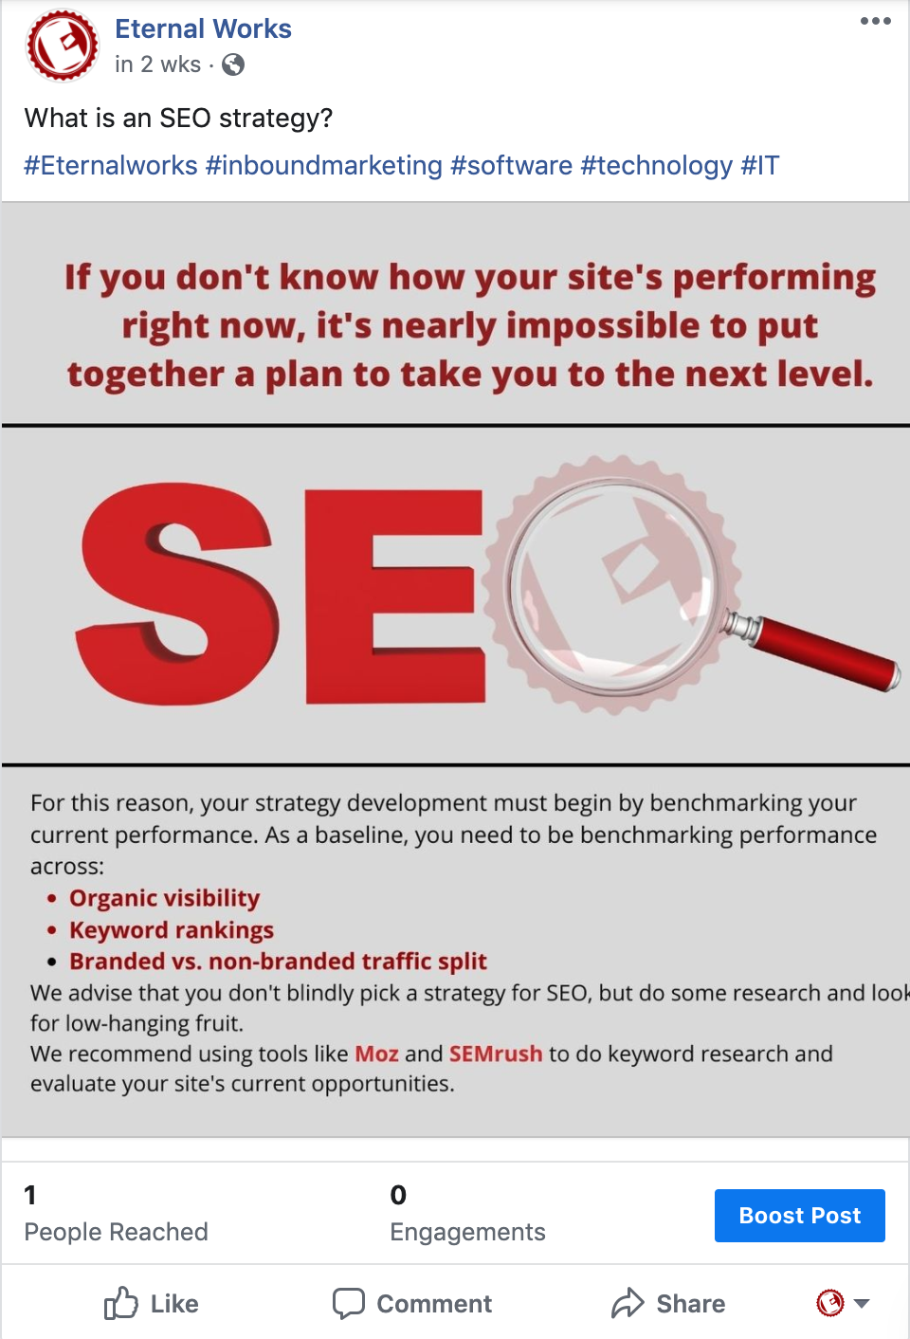
Website Design
Website SEO
Notes:
Platform: LinkedIn/ Facebook
Caption: What is an SEO strategy?
Hashtags: #Eternalworks #inboundmarketing #DigitalMarketing
Why it works: This post would entice the audience to go to the website to learn more about SEO strategy and every other thing that Eternal Works is an expert in.
Right Pic
platform: LinkedIn
Caption: These tools are great to evaluate a newly built website or help when you are considering a website redesign. You can quickly discover areas of a site that warrant improvement.
Hashtags: #Eternalworks #inboundmarketing
Why it works: This post will be a helpful infographic for your current and potential audience to use, showing them you are a resource for people in need of web design services. This would lead them to your website to find more useful information, where they would find out what other services your company has to offer.

Slide 25
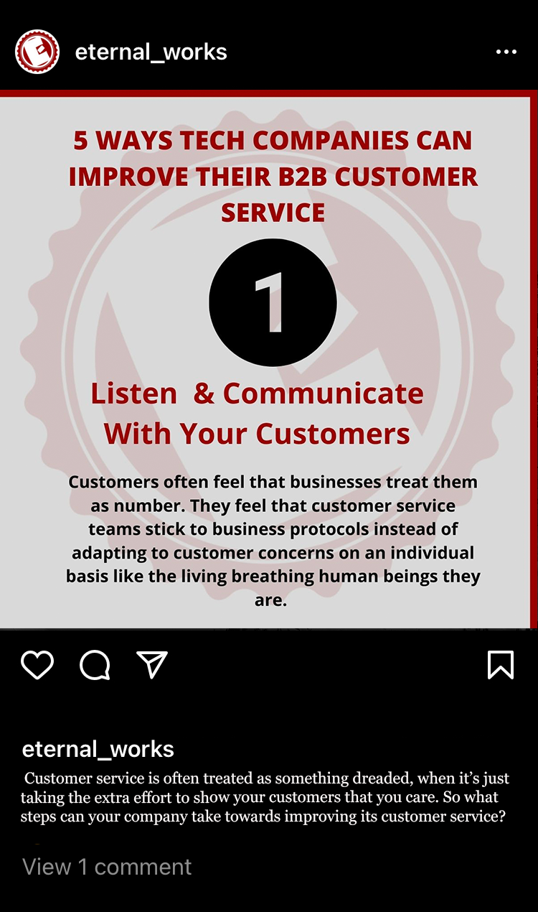
IT & Software Industry
Notes:
Left Pic
Platform: Instagram/ Linkedin
Series: yes - 5
Caption: 5 WAYS TECH COMPANIES CAN IMPROVE THEIR B2B CUSTOMER SERVICE
Customer service is often treated as something dreaded, when it’s just taking the extra effort to show your customers that you care. So what steps can your company take towards improving its customer service?
Hashtags: #Eternalworks #inboundmarketing #software #technology #IT
Why it works: This post will engage more Tech companies on your company website. Include the link to the article - https://www.eternalworks.com/blog/5-ways-tech-companies-can-improve-their-b2b-customer-service
Right Pic
Platform: LinkedLn/ Facebook
Caption: 6 WAYS SOFTWARE COMPANIES CAN REDUCE CHURN
Now that we've established several factors leading to B2B churn, what are some possible solutions? Remember that there is no quick fix to lowering churn. It’s a constant commitment.
Hashtags: #Eternalworks #inboundmarketing #software #technology #IT
Why it Works: This post would help establish a target audience to the IT and Software companies. Include the link to the article - https://www.eternalworks.com/blog/5-ways-software-companies-can-reduce-churn

Slide 26
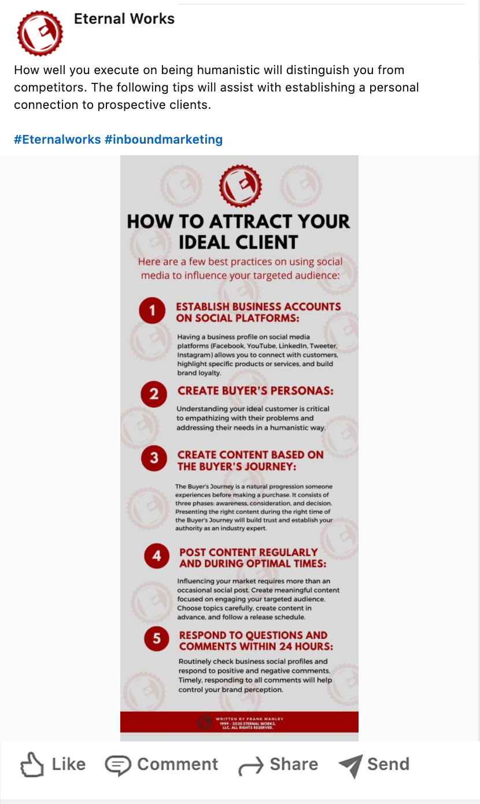
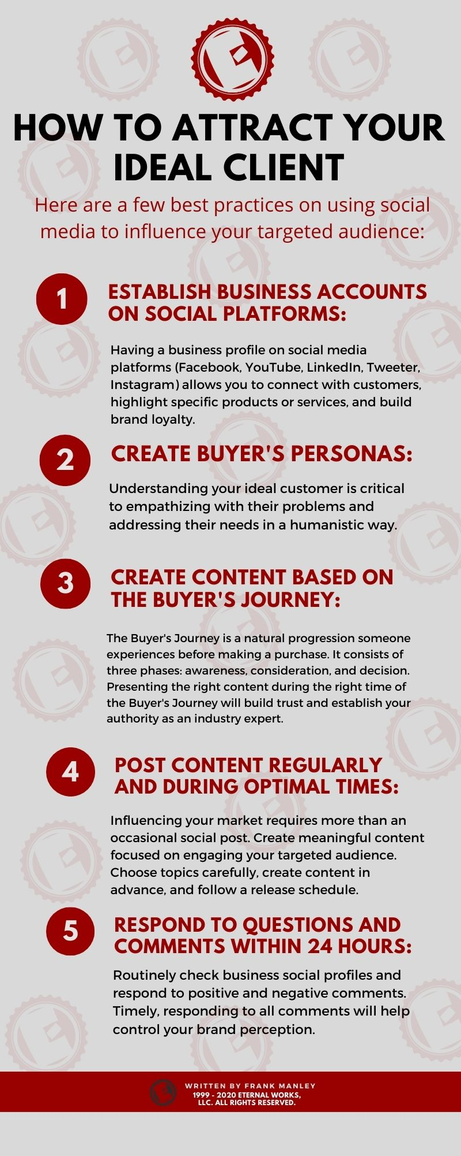
Grow your Business
Notes:
Platform: LinkedIn
Caption: How well you execute on being humanistic will distinguish you from competitors. The following tips will assist with establishing a personal connection to prospective clients.
Hashtags: #Eternalworks #inboundmarketing
Why it works: This post will attract prospective clients by engaging people using these practices. This post would also be linked to the corresponding article for people to click on.

Slide 27
Content Calendar

Slide 28
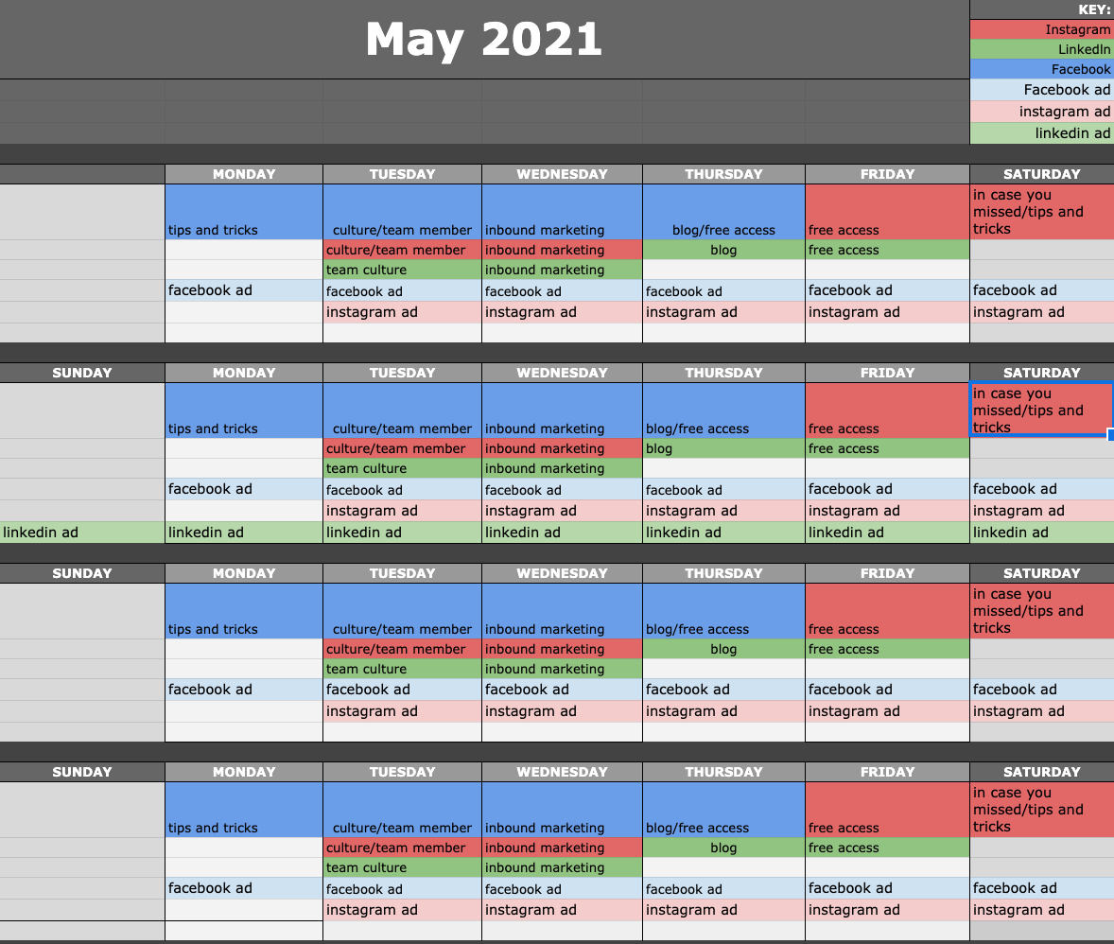

Slide 29
Social Media Budget
Notes:
Based on your budget of $500-$1000/month, we recommend focusing on Facebook and Instagram ads at first.
Once your ROI is at a level you are comfortable with, once a month you can splurge and have 1 ad run for 7 days on LinkedIn before you hit the top of your budget.
Content calendar

Slide 30
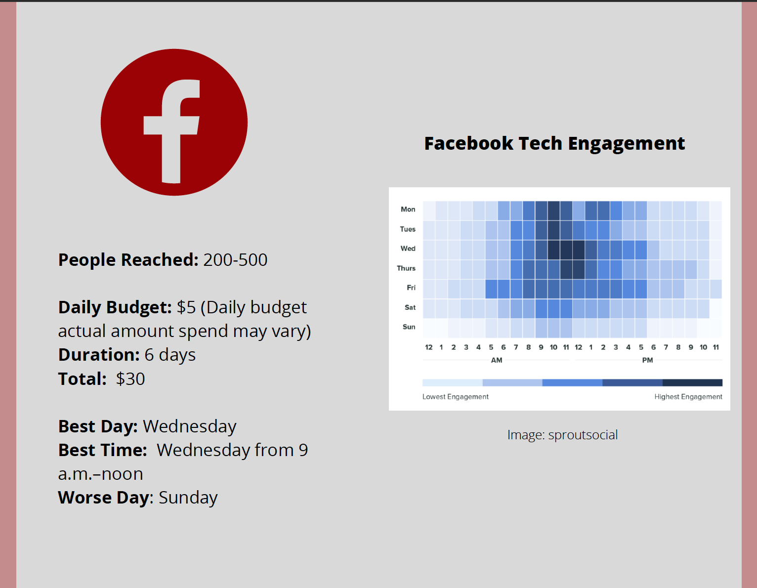
People Reached: 200 - 500
Daily Budget: $5 ( Daily Budget actual amount spend may vary)
Duration: 6 Days
Total: $30
Best Day: Wednesday
Best Time: Wednesday from 9 a.m.- noon
Worse Day: Sunday

Slide 31
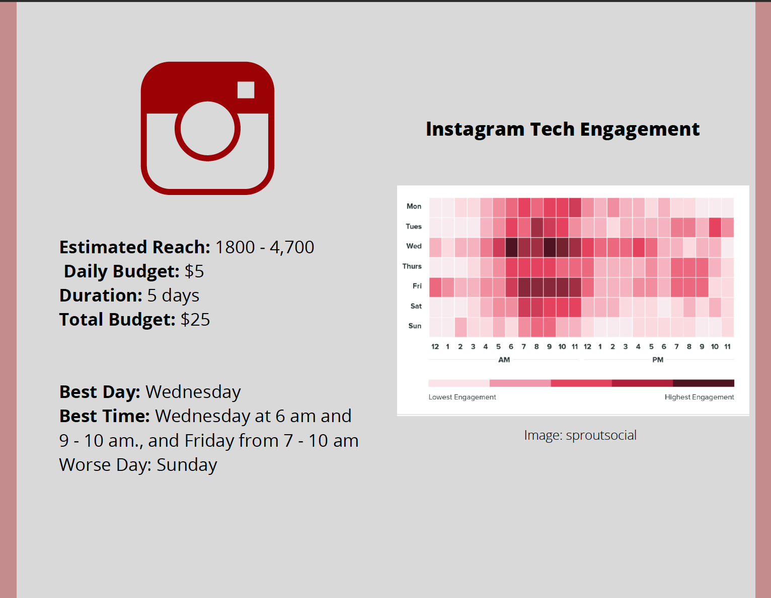
Estimated Reached: 1800 - 4,700
Daily Budget: $5
Duration: 5 Days
Total: $25
Best Day: Wednesday
Best Time: Wednesday from 6 a.m. amd 9 - 10 a.m., and Friday from 7 - 10 a.m.
Worse Day: Sunday

Slide 32
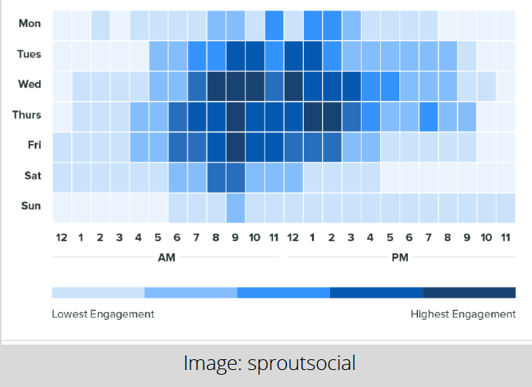
Estimated Reached: 8,100 - 38,000
Daily Budget: $7-36
Duration: 7 Days
Total: $120-250
Best Day: Wednesday & Thursday
Best Time: Wednesday from 8 - 10 a.m., and noon, Thursday at 9 a.m. and 1-2 p.m., and Friday at 9 a.m.

Slide 33




Recommendation to Make Content Cohesive for Given Target Audience
Notes:
To make sure that the content is cohesive for the target audience, make sure to pay attention to who your audience is and how they interact with your company.
Track what kind of content they consume and find interesting and then use those topics to produce more blogs, infographics, videos, etc. that they find valuable and interesting to read.
For all social media platforms, the content produced should have a balanced color palette and use the same fonts to help your viewers know whose content they are looking at without even looking at the account name.
In the same way that you have a style guide for your company's visual designs, you need to develop standards for your content.
When creating content for your specific target audience, make sure the content is relevant for them so they find what they see interesting enough to lead them back to your main website where they will see who Eternal works is and what you offer.
The type of content that will do this is the type that will help them with their problems.
Continue using a content calendar with a key and a timesheet to keep you on track with posting consistently to gain the widest audience possible.
As well, having the team interact with the company's social media and share in their personal accounts will create more interaction and new prospects.

Slide 34




Social Media Recommendation
Notes:
Linkedin, facebook, instagram only. Until comfortable with content to post
Linkedin is professional- update bio. 2000 word limit so expand
Instagram is social- team focused, tips and tricks, blogs, testimonials
Instagram stories. Can be saved to main page
Updates on daily work life/ big things happening.
Facebook is in between- merging both social aspects of business, and the professional aspects of business.
Bio also like linkedin- expand on who ew is
little to no stock images.
Loses a level of personalization
Use your skills, show them you know what you’re doing
keep your captions short and sweet.
keep your links in your bio and to add your hashtags in the comment section.
Hashtags- make sure to use them.
People follow hashtags
Facebook. Make sure to utilize them because they make your post searchable to everyone.
Popularity
Content should be about the services your business provides, the culture of the company, testimonials from different team members and clients talking about their experience with E-W.

Slide 35




Recommendations for the Future
Notes:
Navigation bar-blog post ex.
Color scheme- lots of grey, want some pop of color to reduce bounce rate
Hiring someone to manage social media
one for website maintenance
Hubspot to post continuously-higher engagement=more leads

Slide 36
Thank you

